Slide 2
Can We Trust the Gospels?

Slide 3
What do you suppose happened to the stories over the years, as they were told and retold, not as disinterested news stories reported by eyewitnesses but as propaganda meant to convert people to faith, told by people who had themselves heard them fifth- or sixth- or nineteenth-hand? Did you or your kids ever play the telephone game at a birthday party?
Bart Ehrman, Jesus Interrupted, 146-7

Slide 4
Bart Ehrman suggests that the stories found in the Gospels were corrupted (intentionally) over time with each retelling until they were finally written down.
Commonly suggested evidence of this corruption:
Miracles
Prophecy
Deity of Christ
Tests that we can apply to see if this corruption is true:
Name
Geography

Slide 5
Name Test
Does anybody here have a hard time remembering names?
A name is a detail that is easily corrupted in a situation like Bart Ehrman describes because it is a very minor detail that is seemingly random.
We can’t prove whether the Bible has correctly recorded the names of characters in the stories but we can test to see if they appear in the right proportions.

Slide 6
Name Frequency in Israel (330 BC to 200 AD)
Rank | Name | Total | NT | Josephus | Ossuaries | DS Scrolls
1 | Simon/Simeon | 243 | 8 | 29 | 59 | 72
2 | Joseph/Joses | 218 | 6 | 21 | 45 | 78
3 | Lazarus/Eleazar | 166 | 1 | 20 | 29 | 52
4 | Judas/Judah | 164 | 5 | 14 | 44 | 35
5 | John/Johanan | 122 | 5 | 13 | 25 | 40
6 | Jesus/Joshua | 99 | 2 | 14 | 22 | 38
7 | Ananias | 82 | 2 | 10 | 18 | 13
8 | Jonathan | 71 |  | 14 | 14 | 21
9 | Matthew/Mattathias | 62 | 2 | 12 | 17 | 15
10 | Manaen/Menahem | 42 | 1 | 2 | 4 | 23
11 | James/Jacob | 40 | 5 | 4 | 5 | 10

Slide 7
Correlation of Names
 | % of all in Israel | % of all in Gospels/Acts
Men with one of the two most popular names, Simon or Joseph | 15.60% | 18.20%
Men with one of the nine most popular names | 41.50% | 40.30%

Slide 8
Popular names by Region
Name | Rank in Egypt | Rank in Israel
Eleazar | 1 | 3
Sabbataius | 2 | 68=
Joseph | 3 | 2
Dositheus | 4= | 16
Pappus | 4= | 39=
Ptolemaius | 6= | 50=
Samuel | 6= | 23

Slide 9
Simon
Simon Peter (Matthew 4:18)
Simon the brother of Jesus (Matthew 13:55)
Simon the Cyrenian (Matthew 27:32)*
Simon the Zealot/Canaanite (Mark 3:18)
Simon the Leper (Mark 14:3)
Simon the father of Judas Iscariot (John 6:71)
Simon the Sorcerer (Acts 8:9)
Simon the Tanner (Acts 9:43)
Simeon (Luke 2:25)
Simeon called Niger (Acts 13:1)*

Slide 10
Disambiguation
Jesus talking to James. Which James?
Now the names of the twelve apostles are these: first, Simon [1], who is called Peter, and Andrew [>99] his brother; James [11] the son of Zebedee, and John [5] his brother; Philip [61=] and Bartholomew [50=]; Thomas [>99] and Matthew [9] the tax collector; James [11] the son of Alphaeus, and Lebbaeus, whose surname was Thaddaeus [39=]; Simon [1] the Canaanite, and Judas [4] Iscariot, who also betrayed Him.
Matthew 10:2-4

Slide 11
Simon [1], who is called Peter
Simon [1] the Canaanite
Judas [4] Iscariot, who also betrayed Him
John [5] his brother
Matthew [9] the tax collector
James [11] the son of Zebedee
James [11] the son of Alphaeus
Thaddaeus [39=]
Bartholomew [50=]
Philip [61=]
Thomas [>99]
Andrew [>99] his brother

Slide 12
How does this compare against the apocryphal Gospels?
Gospel of Thomas has only 7 names: James the Just, Jesus, Mary, Matthew, Salome, Simon Peter, and Thomas
Gospel of Mary has only 5 names: Andrew, Levi, Mary, Peter, and “the Savior” ← the type of thing Bart Ehrman spoke about.
Gospel of Judas has just two names suitable for Israeli men: Judas and Jesus. It does have many names not suited for Jews anywhere: Barbelo, Nebro, Yaldabaoth, and Yobel.

Slide 13
(114)
(1) Simon Peter said to them: “Let Mary go away from us, for women are not worthy of life.” (2) Jesus said: “Look, I will draw her in so as to make her male, so that she too may become a living male spirit, similar to you.” (3) (But I say to you): “Every woman who makes herself male will enter the kingdom of heaven.”

Slide 14
One notable feature about names is that they are often difficult to remember. This is hardly surprising since most…are assigned rather arbitrarily. There is usually no memorable reason why an individual should be called one of the many names that are conventional within a given culture. So we regularly forget names even as we remember many other things about people. In social settings we can often recall details of the last conversation we had with someone even as we struggle to remember his…name. We watch a film and remember its characters and what they did, but often forget the names of those characters. Stories, as coherent threads, are easier to remember than names as arbitrary labels.
Peter J. Williams, Can We Trust the Gospels? 76.

Slide 15
Geography Test
Is there sufficient geographical detail in the Gospels to demonstrate that they are likely careful eyewitness accounts?

Slide 16
 | Matthew | Mark | Luke | John
Aenon |  |  |  | x
Arimathea | x | x | x | x
Bethany | x | x | x | x
Bethlehem | x |  | x | x
Bethphage | x | x | x
Bethsaida | x | x | x | x
Caesarea Philippi | x | x
Cana |  |  |  | x
Capernaum | x | x | x | x
Chorazin | x |  | x
Dalmanutha |  | x
Emmaus |  |  | x
Ephraim |  |  |  | x
Gennesaret | x | x | x
Jericho | x | x | x
Jerusalem | x | x | x | x
Magadan | x
Nain |  |  | x
Nazareth | x | x | x | x
Rama | x
Salim |  |  |  | x
Sidon | x | x | x
Sychar |  |  |  | x
Tiberias |  |  |  | x
Tyre | x | x | x
Zarephath |  |  | x

Slide 17
 | Matthew | Mark | Luke | John | Thomas* | Philip* | Judas*
Aenon |  |  |  | x
Arimathea | x | x | x | x
Bethany | x | x | x | x
Bethlehem | x |  | x | x
Bethphage | x | x | x
Bethsaida | x | x | x | x
Caesarea Philippi | x | x
Cana |  |  |  | x
Capernaum | x | x | x | x
Chorazin | x |  | x
Dalmanutha |  | x
Emmaus |  |  | x
Ephraim |  |  |  | x
Gennesaret | x | x | x
Jericho | x | x | x
Jerusalem | x | x | x | x |  | x
Magadan | x
Nain |  |  | x
Nazareth | x | x | x | x |  | x
Rama | x
Salim |  |  |  | x
Sidon | x | x | x
Sychar |  |  |  | x
Tiberias |  |  |  | x
Tyre | x | x | x
Zarephath |  |  | x

Slide 18
 | Matthew | Mark | Luke | John | Thomas* | Philip* | Judas*
Aenon |  |  |  | x
Arimathea | x | x | x | x
Bethany | x | x | x | x
Bethlehem | x |  | x | x
Bethphage | x | x | x
Bethsaida | x | x | x | x
Caesarea Philippi | x | x
Cana |  |  |  | x
Capernaum | x | x | x | x
Chorazin | x |  | x
Dalmanutha |  | x
Emmaus |  |  | x
Ephraim |  |  |  | x
Gennesaret | x | x | x
Jericho | x | x | x
Jerusalem | x | x | x | x |  | x
Magadan | x
Nain |  |  | x
Nazareth | x | x | x | x |  | x
Rama | x
Salim |  |  |  | x
Sidon | x | x | x
Sychar |  |  |  | x
Tiberias |  |  |  | x
Tyre | x | x | x
Zarephath |  |  | x

Slide 19
 | Matthew | Mark | Luke | John
Abilene |  |  | x
Decapolis | x | x
Egypt | x
Galilee | x | x | x | x
Idumaea |  | x
Ituraea |  |  | x
Judaea | x | x | x | x
Naphtali | x
Samaria |  |  | x | x
Sidonia |  |  | x
Syria | x |  | x
Trachonitis |  |  | x
Zebulun | x

Slide 20
 | Matthew | Mark | Luke | John | Thomas* | Philip* | Judas*
Abilene |  |  | x
Decapolis | x | x
Egypt | x
Galilee | x | x | x | x
Idumaea |  | x
Ituraea |  |  | x
Judaea | x | x | x | x | x
Naphtali | x
Samaria |  |  | x | x
Sidonia |  |  | x
Syria | x |  | x
Trachonitis |  |  | x
Zebulun | x

Slide 21
 | Matthew | Mark | Luke | John | Thomas* | Philip* | Judas*
Abilene |  |  | x
Decapolis | x | x
Egypt | x
Galilee | x | x | x | x
Idumaea |  | x
Ituraea |  |  | x
Judaea | x | x | x | x | x
Naphtali | x
Samaria |  |  | x | x
Sidonia |  |  | x
Syria | x |  | x
Trachonitis |  |  | x
Zebulun | x

Slide 22
Sea (θάλασσα)
 | # | Galilee (θάλασσα) | Galilee (λίμνη)
Matthew | 16 | 12 | 0
Mark | 19 | 17 | 0
Luke | 3 | 0 | 5
John | 9 | 9 | 0

Slide 23
Contradictions? - Feeding of the 5,000
We often hear that there are contradictions in overlapping portions of the Gospels.
Instead of contradictions we actually find an amazing amount of cohesion amongst the Gospel accounts.

Slide 24
Matthew 14:13-21; Mark 6:31-44; Luke 9:10-17; John 6:1-15
Matthew 14:13 | Deserted place
Luke 9:10 | Deserted place belonging to Bethsaida
Mark 6:31 | Many coming and going
John 6:4 | Passover was near
John 6:5 | Jesus speaks to Philip (John 1:44)
John 6:10 | Much grass
Mark 6:39 | Green grass
Mark 6:40 | Sat down in 100s and 50s
Luke 9:14 | Make them sit in 50s
John 6:9 | Barley loaves

Slide 25
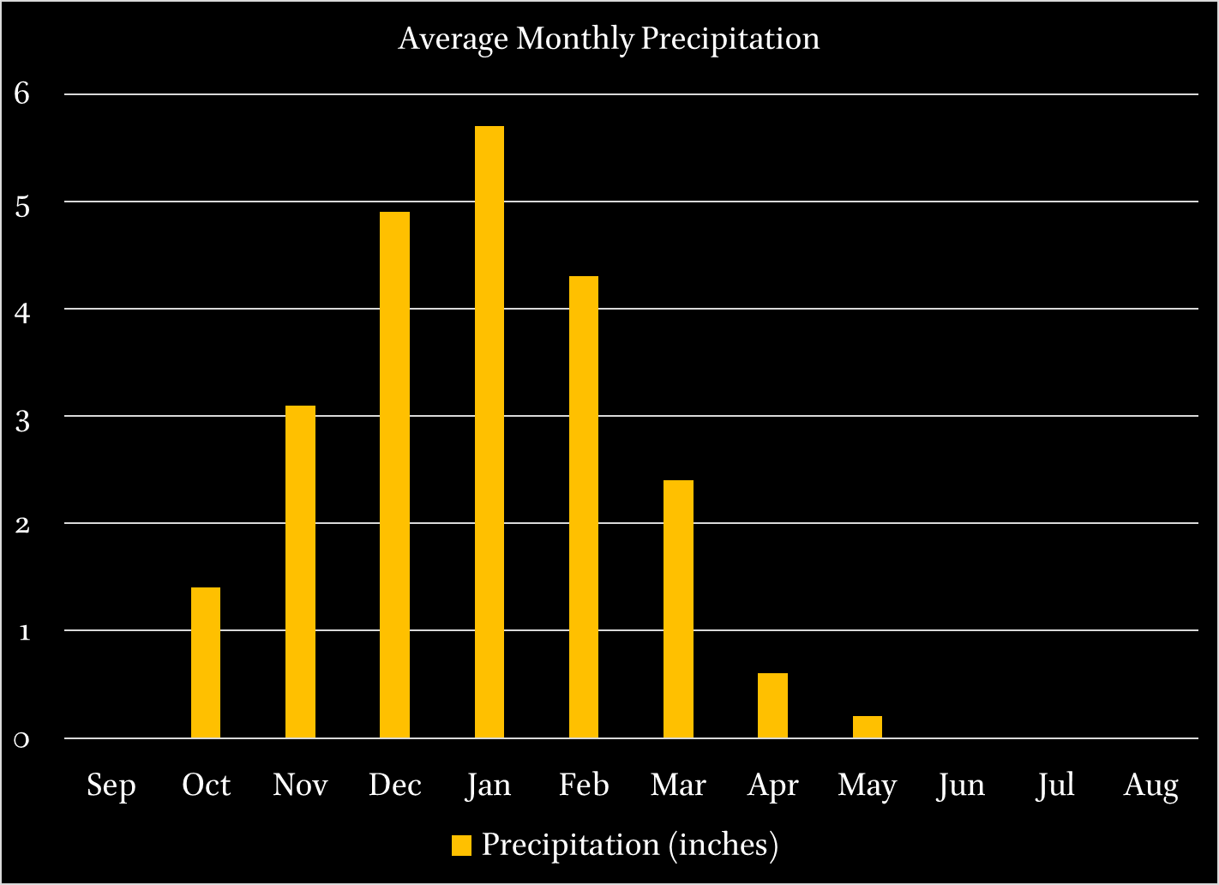
Passover

Slide 26
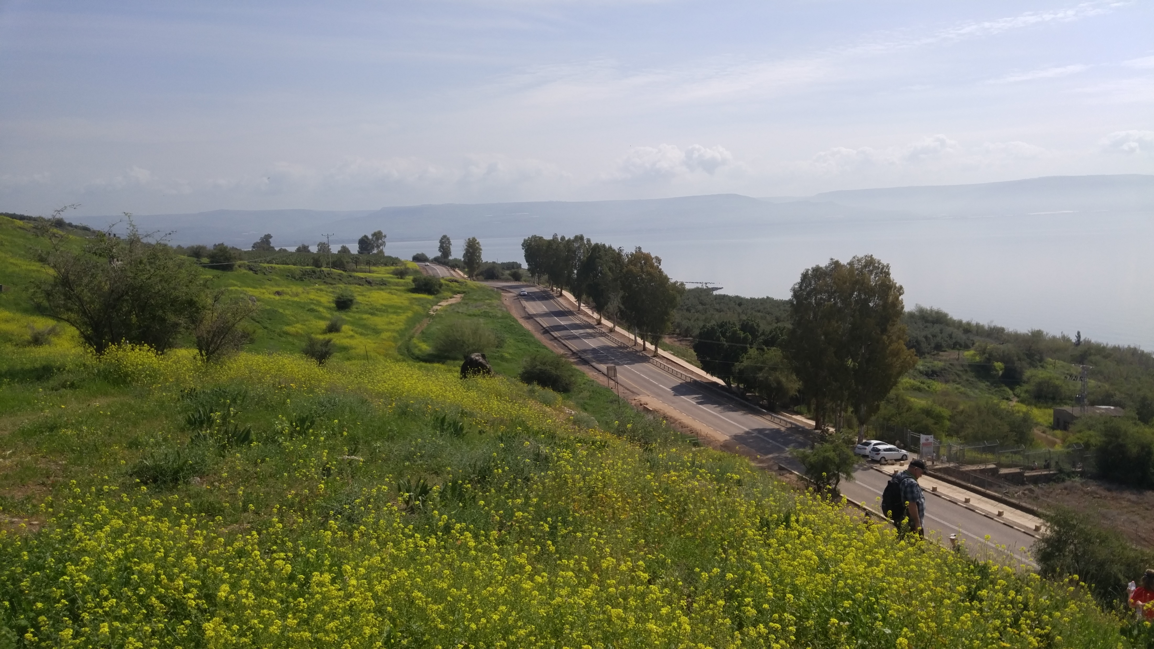

Slide 27
Matthew 14:13-21; Mark 6:31-44; Luke 9:10-17; John 6:1-15
Matthew 14:13 | Deserted place
Luke 9:10 | Deserted place belonging to Bethsaida
Mark 6:31 | Many coming and going
John 6:4 | Passover was near
John 6:5 | Jesus speaks to Philip (John 1:44)
John 6:10 | Much grass
Mark 6:39 | Green grass
Mark 6:40 | Sat down in 100s and 50s
Luke 9:14 | Make them sit in 50s
John 6:9 | Barley loaves

